Slide 1
Training Results Log

Slide 2
Results 1
Weight path: “~\weights\simulation\space_time\space_time_cam_can_imu_5k_L.pth”
Sensor Inputs: Rear mirror cameras, CAN steer, CAN velocity, Ay IMU, Raw rate IMU
Fusion Method: Early Concatenation
Outputs: Hitch, Hitch rate
Architecture: Dimensions: 384. Heads: 8. Depth: 12. Image Size: 224x224. Patch Size: 16
Loss: L1 Loss
Batch Size: 6
Final Results: 22 epochs. Training RMSE: (0.63629967, 0.98244935), Val RMSE: (0.99091375 1.4172454)

Slide 3
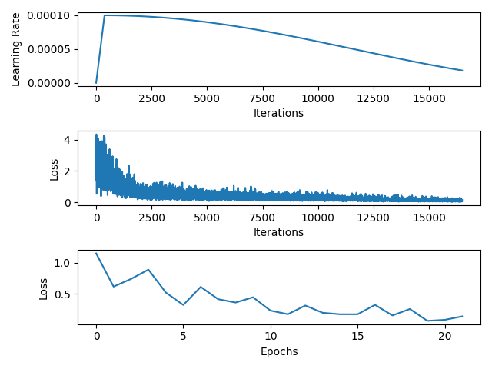
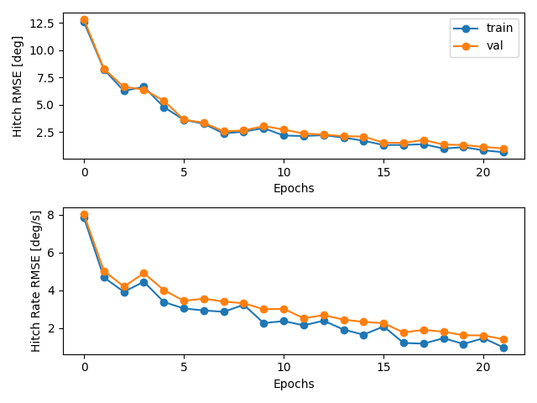
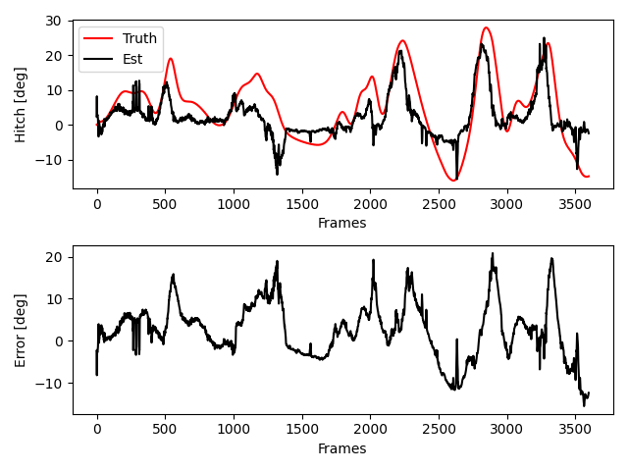
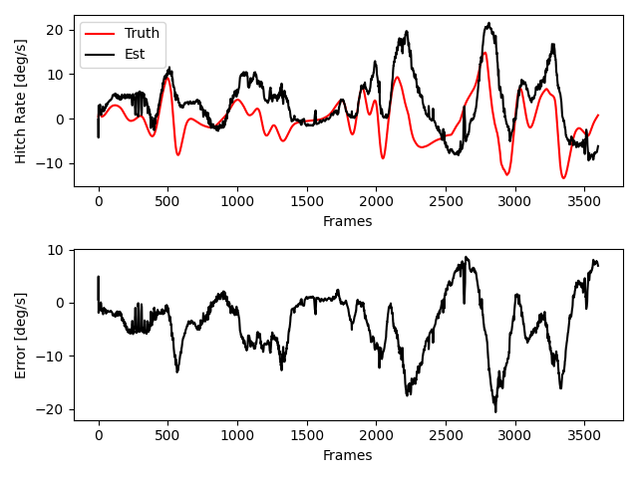
Results 1

Slide 4
Results 2
Weight path: “~\weights\simulation\space_time\space_time_cam_can_imu_5k_M.pth”
Sensor Inputs: Rear mirror cameras, CAN steer, CAN velocity, Ay IMU, Raw rate IMU
Fusion Method: Early Concatenation
Outputs: Hitch, Hitch rate
Architecture: Dimensions: 768. Heads: 8. Depth: 12. Image Size: 224x224. Patch Size: 16
Loss: L1 Loss
Batch Size: 4
Final Epochs: 30 epochs

Slide 5
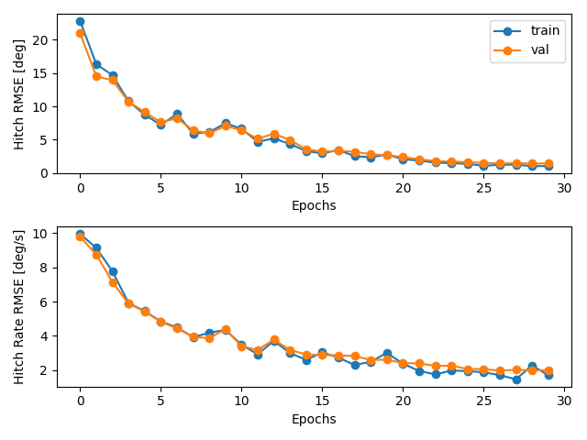
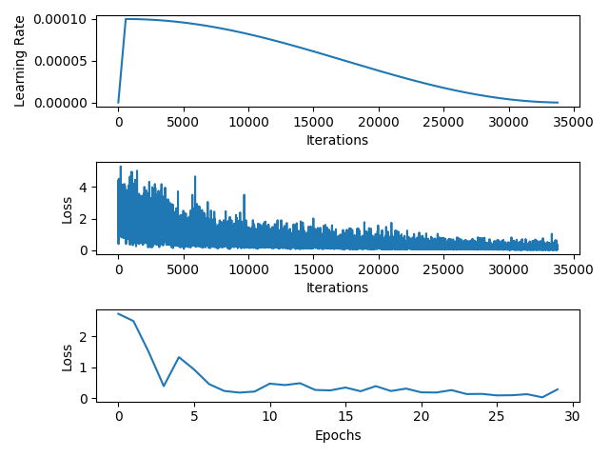
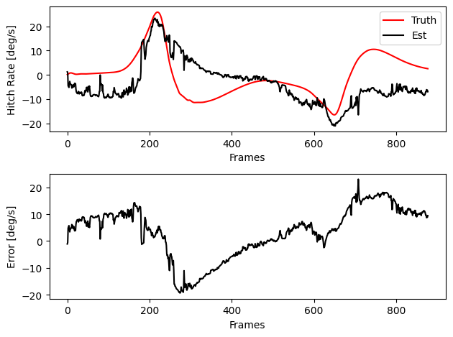
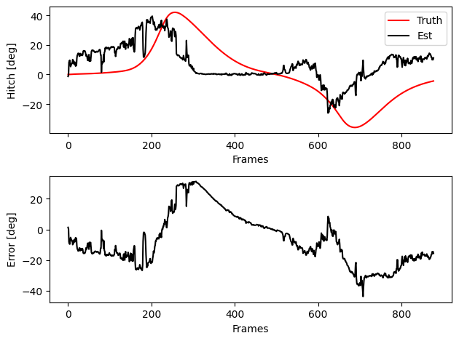
Results 2

